Slide 1
Detection Error Probability Maximization for Disguised Full-Duplex Covert Communications
Mar. 29, 2024
Refat Khan, and Jihwan Moon

Slide 2
Table of Contents
1. Introduction
2. System model
3. Problem formulation
4. Proposed solutions
5. Numerical results

Slide 3
1. Introduction

Slide 4
2. System model

Slide 5




2. System model
2.1 Schematic diagram
Hidden receiver, R
Covert message
Self-interference
Public message
Source, S
Disguised FD destination, D
Warden, W

Slide 6

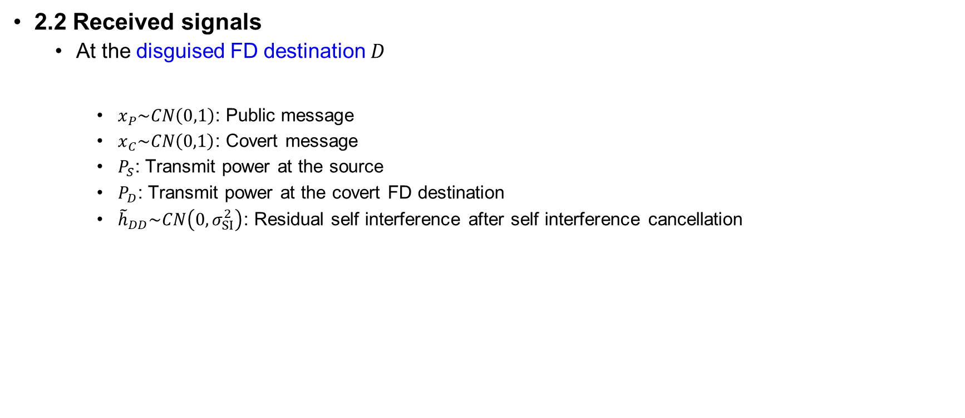


2. System model
2.2 Received signals
At the disguised FD destination $D$
$x_{P}\sim CN\left(0,1\right)$: Public message
$x_{C}\sim CN\left(0,1\right)$: Covert message
$P_{S}$: Transmit power at the source
$P_{D}$: Transmit power at the covert FD destination
${\tilde{h}}_{DD}\sim CN\left(0,σ_{SI}^{2}\right)$: Residual self interference after self interference cancellation
$$y_{D}=h_{SD}\sqrt{P_{S}}x_{P}+{\tilde{h}}_{DD}\sqrt{P_{D}}x_{C}+z_{D}$$
Public message,$x_{P}$
Covert message, $x_{C}$
Source, S
Disguised FD destination, D

Slide 7



2. System model
2.2 Received signals
At the disguised FD destination $D$
Channel capacity for the public message
Adaptive transmission policy with rate $r_{P}≤{\overline{r}}_{P,D}$ assumed, based on the feedback from the destination
$${\bar{r}}_{P,D}=\log_{2}\left(1+\frac{{\left|h_{SD}\right|}^{2}P_{S}}{{\left|{\tilde{h}}_{DD}\right|}^{2}P_{D}+σ_{D}^{2}}\right)$$
Public message, $x_{P}$
Covert message, $x_{C}$
Source, S
Disguised FD destination, D

Slide 8


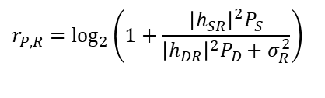


2. System model
2.2 Received signals
At the hidden receiver $R$
Channel capacity for the public message by treating the covert message as interference (if $r_{P}≤{\overline{r}}_{P,R}$)
$$y_{R}=h_{SR}\sqrt{P_{S}}x_{P}+h_{DR}\sqrt{P_{D}}x_{C}+z_{R}$$
$${\bar{r}}_{P,R}=\log_{2}\left(1+\frac{{\left|h_{SR}\right|}^{2}P_{S}}{{\left|h_{DR}\right|}^{2}P_{D}+σ_{R}^{2}}\right)$$
Public message, $x_{P}$
Covert message, $x_{C}$
Source, S
Hidden
receiver, R
Disguised FD destination, D

Slide 9


2. System model
2.2 Received signals
At the hidden receiver $R$
Achievable rate for the covert message after canceling the decoded public message
$$y_{R}=h_{SR}\sqrt{P_{S}}x_{P}+h_{DR}\sqrt{P_{D}}x_{C}+z_{R}$$
$$r_{C,R}=\log_{2}\left(1+\frac{{\left|h_{DR}\right|}^{2}P_{D}}{σ_{R}^{2}}\right)$$
Public message, $x_{P}$
Covert message, $x_{C}$
Source, S
Hidden
receiver, R
Disguised FD destination, D

Slide 10




2. System model
2.2 Received signals
At the warden $W$
$$y_{W}=h_{SW}\sqrt{P_{S}}x_{P}+h_{DW}\sqrt{P_{D}}x_{C}+z_{W}$$
Public message, $x_{P}$
Covert message, $x_{C}$
Source, S
Warden, W
Disguised FD destination, D

Slide 11

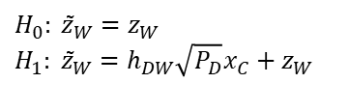


2. System model
2.3 Covert message detection
The worst-case assumption: $P_{D}$ known at the detector [HTa:20]
The effective residual signal assuming the warden successfully decoded $x_{P}$
The null and alternative hypotheses
The test statistics $T=E\left[{\left|{\tilde{z}}_{W}\right|}^{2}\right]$
$${\tilde{z}}_{W}=y_{W}−h_{SW}\sqrt{P_{S}}x_{P}$$
$$H_{0}: {\tilde{z}}_{W}=z_{W} \\ H_{1}: {\tilde{z}}_{W}=h_{DW}\sqrt{P_{D}}x_{C}+z_{W}$$
$$H_{0}: T=σ_{W}^{2} \\ H_{1}: T={\left|h_{DW}\right|}^{2}P_{D}+σ_{W}^{2}$$

Slide 12
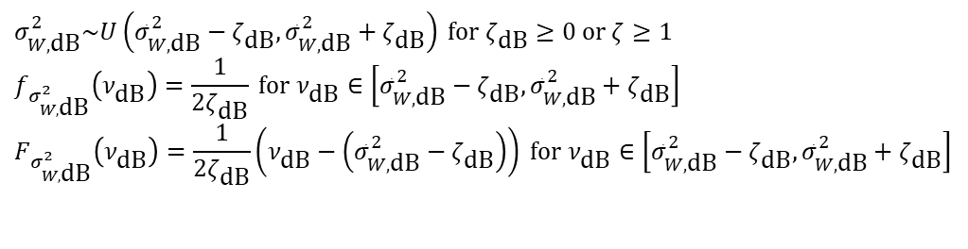
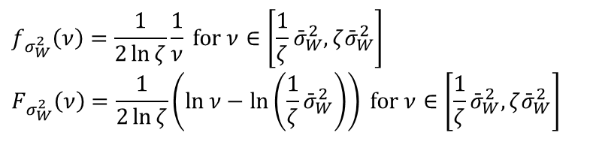
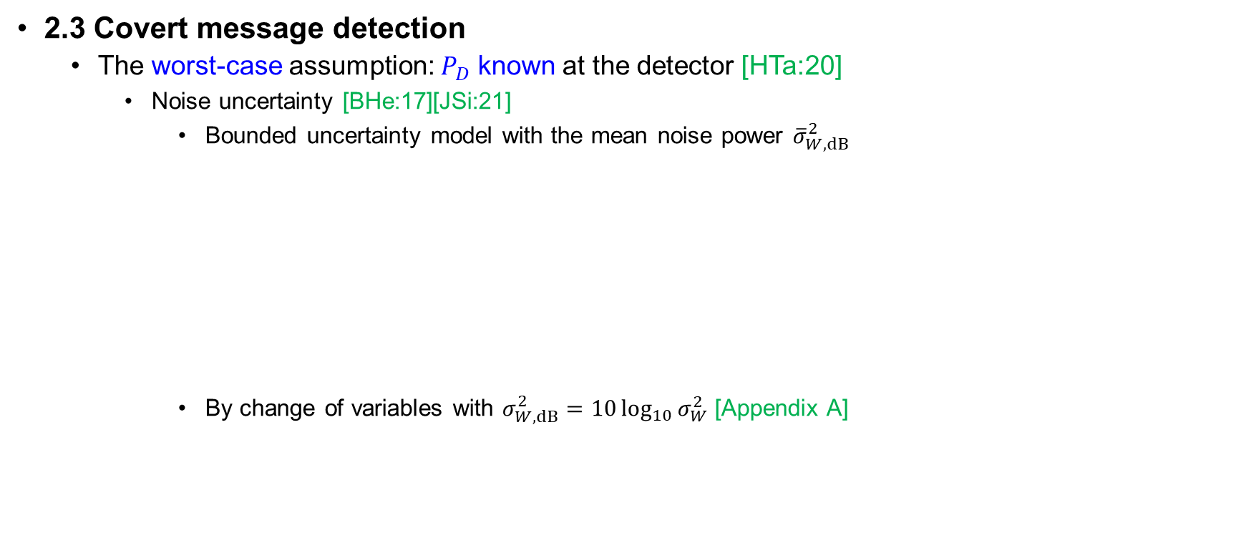
2. System model
2.3 Covert message detection
The worst-case assumption: $P_{D}$ known at the detector [HTa:20]
Noise uncertainty [BHe:17][JSi:21]
Bounded uncertainty model with the mean noise power ${\overline{σ}}_{W,dB}^{2}$
By change of variables with $σ_{W,dB}^{2}=10\log_{10}{σ_{W}^{2}}$ [Appendix A]
$$σ_{W,\text{dB}}^{2}\sim U\left({\bar{σ}}_{W,\text{dB}}^{2}−ζ_{\text{dB}},{\bar{σ}}_{W,\text{dB}}^{2}+ζ_{\text{dB}}\right) \text{for} ζ_{\text{dB}}≥0 \text{or} ζ≥1 \\ f_{σ_{W,\text{dB}}^{2}}\left(ν_{\text{dB}}\right)=\frac{1}{2ζ_{\text{dB}}} \text{for} ν_{\text{dB}}∈\left[{\bar{σ}}_{W,\text{dB}}^{2}−ζ_{\text{dB}},{\bar{σ}}_{W,\text{dB}}^{2}+ζ_{\text{dB}}\right] \\ F_{σ_{W,\text{dB}}^{2}}\left(ν_{\text{dB}}\right)=\frac{1}{2ζ_{\text{dB}}}\left(ν_{\text{dB}}−\left({\bar{σ}}_{W,\text{dB}}^{2}−ζ_{\text{dB}}\right)\right) \text{for} ν_{\text{dB}}∈\left[{\bar{σ}}_{W,\text{dB}}^{2}−ζ_{\text{dB}},{\bar{σ}}_{W,\text{dB}}^{2}+ζ_{\text{dB}}\right]$$
$$f_{σ_{W}^{2}}\left(ν\right)=\frac{1}{2\ln{ζ}}\frac{1}{ν} \text{for} ν∈\left[\frac{1}{ζ}{\bar{σ}}_{W}^{2},ζ{\bar{σ}}_{W}^{2}\right] \\ F_{σ_{W}^{2}}\left(ν\right)=\frac{1}{2\ln{ζ}}\left(\ln{ν}−\ln\left(\frac{1}{ζ}{\bar{σ}}_{W}^{2}\right)\right) \text{for} ν∈\left[\frac{1}{ζ}{\bar{σ}}_{W}^{2},ζ{\bar{σ}}_{W}^{2}\right]$$

Slide 13

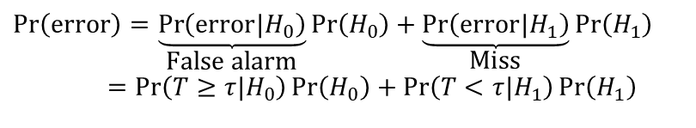

2. System model
2.3 Covert message detection
The worst-case assumption: $P_{D}$ known at the detector [HTa:20]
Decision based on a threshold $τ$
Detection error probability (DEP)
False alarm probability
$$T\begin{matrix}\overset{H_{1}}{≥} \\ \underset{H_{0}}{<}\end{matrix}τ$$
$$\operatorname{Pr}\left(\text{error}\right)=\underset{\text{False} \text{alarm}}{\underbrace{\operatorname{Pr}\left(\text{error}|H_{0}\right)}}\operatorname{Pr}\left(H_{0}\right)+\underset{\text{Miss}}{\underbrace{\operatorname{Pr}\left(\text{error}|H_{1}\right)}}\operatorname{Pr}\left(H_{1}\right) \\ =\operatorname{Pr}\left(T≥τ|H_{0}\right)\operatorname{Pr}\left(H_{0}\right)+\operatorname{Pr}\left(T<τ|H_{1}\right)\operatorname{Pr}\left(H_{1}\right)$$
$$\operatorname{Pr}\left(T≥τ|H_{0}\right)=\operatorname{Pr}\left(σ_{W}^{2}≥τ\right)=1−F_{σ_{W}^{2}}\left(τ\right)=1−\frac{1}{2\ln{ζ}}\left(\ln{τ}−\ln\left(\frac{1}{ζ}{\bar{σ}}_{W}^{2}\right)\right) \text{for} τ∈\left[\frac{1}{ζ}{\bar{σ}}_{W}^{2},ζ{\bar{σ}}_{W}^{2}\right]$$

Slide 14
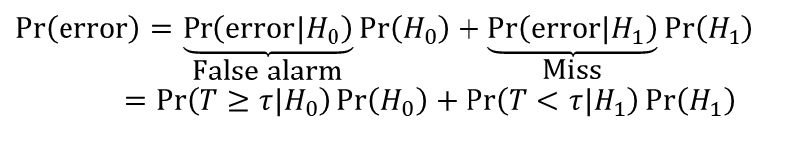
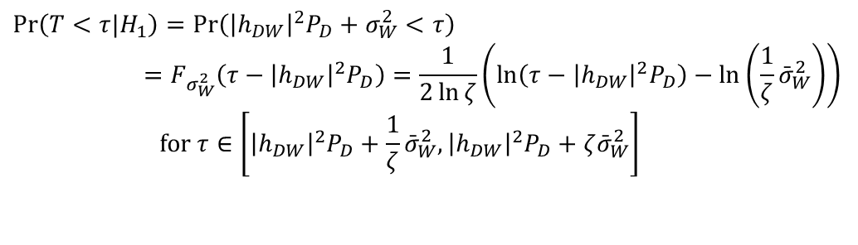

2. System model
2.3 Covert message detection
The worst-case assumption: $P_{D}$ known at the detector [HTa:20]
Decision based on a threshold $τ$
Detection error probability (DEP)
Miss probability
$$T\begin{matrix}\overset{H_{1}}{≥} \\ \underset{H_{0}}{<}\end{matrix}τ$$
$$\operatorname{Pr}\left(\text{error}\right)=\underset{\text{False} \text{alarm}}{\underbrace{\operatorname{Pr}\left(\text{error}|H_{0}\right)}}\operatorname{Pr}\left(H_{0}\right)+\underset{\text{Miss}}{\underbrace{\operatorname{Pr}\left(\text{error}|H_{1}\right)}}\operatorname{Pr}\left(H_{1}\right) \\ =\operatorname{Pr}\left(T≥τ|H_{0}\right)\operatorname{Pr}\left(H_{0}\right)+\operatorname{Pr}\left(T<τ|H_{1}\right)\operatorname{Pr}\left(H_{1}\right)$$
$$\operatorname{Pr}\left(T<τ|H_{1}\right)=\operatorname{Pr}\left({\left|h_{DW}\right|}^{2}P_{D}+σ_{W}^{2}<τ\right) \\ =F_{σ_{W}^{2}}\left(τ−{\left|h_{DW}\right|}^{2}P_{D}\right)=\frac{1}{2\ln{ζ}}\left(\ln\left(τ−{\left|h_{DW}\right|}^{2}P_{D}\right)−\ln\left(\frac{1}{ζ}{\bar{σ}}_{W}^{2}\right)\right) \\ \text{for} τ∈\left[{\left|h_{DW}\right|}^{2}P_{D}+\frac{1}{ζ}{\bar{σ}}_{W}^{2},{\left|h_{DW}\right|}^{2}P_{D}+ζ{\bar{σ}}_{W}^{2}\right]$$

Slide 15
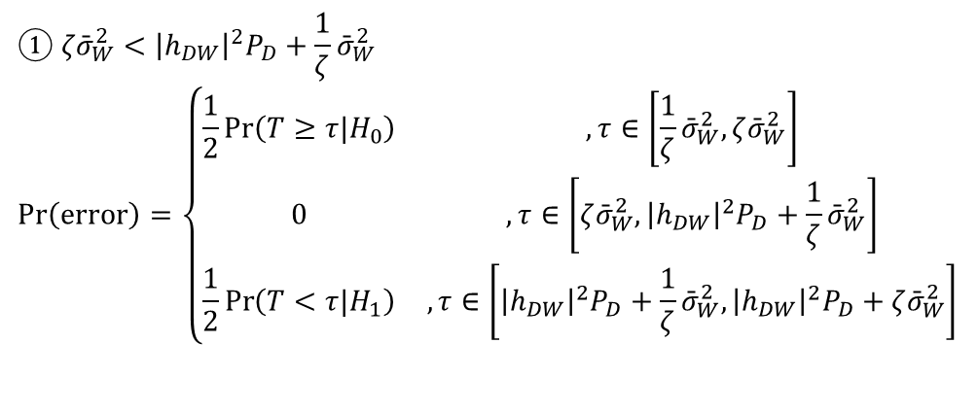

2. System model
2.3 Covert message detection
The worst-case assumption: $P_{D}$ known at the detector [HTa:20]
Decision based on a threshold $τ$
Detection error probability (DEP)
Assuming the equally probable chance of the covert message, $\operatorname{Pr}\left(H_{0}\right)=\operatorname{Pr}\left(H_{1}\right)=\frac{1}{2}$
$$T\begin{matrix}\overset{H_{1}}{≥} \\ \underset{H_{0}}{<}\end{matrix}τ$$
$$① ζ{\bar{σ}}_{W}^{2}<{\left|h_{DW}\right|}^{2}P_{D}+\frac{1}{ζ}{\bar{σ}}_{W}^{2} \\ \operatorname{Pr}\left(\text{error}\right)=\left\{\begin{matrix}\frac{1}{2}\operatorname{Pr}\left(T≥τ|H_{0}\right) & , τ∈\left[\frac{1}{ζ}{\bar{σ}}_{W}^{2},ζ{\bar{σ}}_{W}^{2}\right] \\ 0 & , τ∈\left[ζ{\bar{σ}}_{W}^{2},{\left|h_{DW}\right|}^{2}P_{D}+\frac{1}{ζ}{\bar{σ}}_{W}^{2}\right] \\ \frac{1}{2}\operatorname{Pr}\left(T<τ|H_{1}\right) & , τ∈\left[{\left|h_{DW}\right|}^{2}P_{D}+\frac{1}{ζ}{\bar{σ}}_{W}^{2},{\left|h_{DW}\right|}^{2}P_{D}+ζ{\bar{σ}}_{W}^{2}\right]\end{matrix}\right.$$

Slide 16

2. System model
2.3 Covert message detection
The worst-case assumption: $P_{D}$ known at the detector [HTa:20]
Decision based on a threshold $τ$
Detection error probability (DEP)
Assuming the equally probable chance of the covert message, $\operatorname{Pr}\left(H_{0}\right)=\operatorname{Pr}\left(H_{1}\right)=\frac{1}{2}$
$$T\begin{matrix}\overset{H_{1}}{≥} \\ \underset{H_{0}}{<}\end{matrix}τ$$
$$② ζ{\bar{σ}}_{W}^{2}≥{\left|h_{DW}\right|}^{2}P_{D}+\frac{1}{ζ}{\bar{σ}}_{W}^{2} \\ \operatorname{Pr}\left(\text{error}\right)=\left\{\begin{matrix}\frac{1}{2}\operatorname{Pr}\left(T≥τ|H_{0}\right) & , τ∈\left[\frac{1}{ζ}{\bar{σ}}_{W}^{2},{\left|h_{DW}\right|}^{2}P_{D}+\frac{1}{ζ}{\bar{σ}}_{W}^{2}\right] \\ \frac{1}{2}\left(\operatorname{Pr}\left(T≥τ|H_{0}\right)+\operatorname{Pr}\left(T<τ|H_{1}\right)\right) & , τ∈\left[{\left|h_{DW}\right|}^{2}P_{D}+\frac{1}{ζ}{\bar{σ}}_{W}^{2},ζ{\bar{σ}}_{W}^{2}\right] \\ \frac{1}{2}\operatorname{Pr}\left(T<τ|H_{1}\right) & , τ∈\left[ζ{\bar{σ}}_{W}^{2},{\left|h_{DW}\right|}^{2}P_{D}+ζ{\bar{σ}}_{W}^{2}\right]\end{matrix}\right.$$

Slide 17












2. System model
2.3 Covert message detection
The worst-case assumption: $P_{D}$ known at the detector [HTa:20]
The shape of the DEP function
$$① ζ{\bar{σ}}_{W}^{2}<{\left|h_{DW}\right|}^{2}P_{D}+\frac{1}{ζ}{\bar{σ}}_{W}^{2}$$
$$\operatorname{Pr}\left(\text{error}\right)$$
$$\frac{1}{2}$$
Maximum error
= A random guess
$$\frac{1}{2}\operatorname{Pr}\left(T≥τ|H_{0}\right)$$
$$\frac{1}{2}\operatorname{Pr}\left(T<τ|H_{1}\right)$$
$$0$$
$$τ$$
$$0$$
$$\frac{1}{ζ}{\bar{σ}}_{W}^{2}$$
$$ζ{\bar{σ}}_{W}^{2}$$
$${\left|h_{DW}\right|}^{2}P_{D}+\frac{1}{ζ}{\bar{σ}}_{W}^{2}$$
$${\left|h_{DW}\right|}^{2}P_{D}+ζ{\bar{σ}}_{W}^{2}$$

Slide 18
2. System model
2.3 Covert message detection
The worst-case assumption: $P_{D}$ known at the detector [HTa:20]
The shape of the DEP function
$$① ζ{\bar{σ}}_{W}^{2}<{\left|h_{DW}\right|}^{2}P_{D}+\frac{1}{ζ}{\bar{σ}}_{W}^{2}$$
$$\operatorname{Pr}\left(\text{error}\right)$$
$$\frac{1}{2}$$
Maximum error
= A random guess
$$\frac{1}{2}\operatorname{Pr}\left(T≥τ|H_{0}\right)$$
$$\frac{1}{2}\operatorname{Pr}\left(T<τ|H_{1}\right)$$
$$0$$
$$τ$$
$$0$$
$$\frac{1}{ζ}{\bar{σ}}_{W}^{2}$$
$$ζ{\bar{σ}}_{W}^{2}$$
$${\left|h_{DW}\right|}^{2}P_{D}+\frac{1}{ζ}{\bar{σ}}_{W}^{2}$$
$${\left|h_{DW}\right|}^{2}P_{D}+ζ{\bar{σ}}_{W}^{2}$$

Slide 19
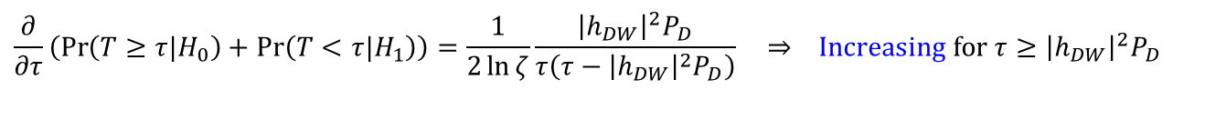
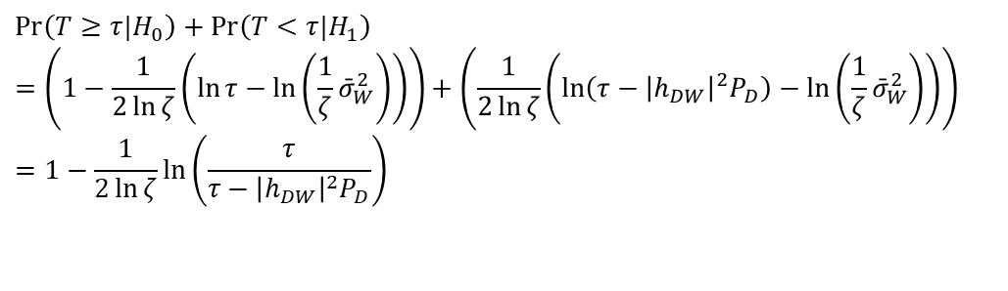


2. System model
2.3 Covert message detection
The worst-case assumption: $P_{D}$ known at the detector [HTa:20]
The shape of the DEP function
Note that
The first derivative
$$② ζ{\bar{σ}}_{W}^{2}≥{\left|h_{DW}\right|}^{2}P_{D}+\frac{1}{ζ}{\bar{σ}}_{W}^{2}$$
$$\operatorname{Pr}\left(T≥τ|H_{0}\right)+\operatorname{Pr}\left(T<τ|H_{1}\right) \\ =\left(1−\frac{1}{2\ln{ζ}}\left(\ln{τ}−\ln\left(\frac{1}{ζ}{\bar{σ}}_{W}^{2}\right)\right)\right)+\left(\frac{1}{2\ln{ζ}}\left(\ln\left(τ−{\left|h_{DW}\right|}^{2}P_{D}\right)−\ln\left(\frac{1}{ζ}{\bar{σ}}_{W}^{2}\right)\right)\right) \\ =1−\frac{1}{2\ln{ζ}}\ln\left(\frac{τ}{τ−{\left|h_{DW}\right|}^{2}P_{D}}\right)$$
$$\frac{∂}{∂τ}\left(\operatorname{Pr}\left(T≥τ|H_{0}\right)+\operatorname{Pr}\left(T<τ|H_{1}\right)\right)=\frac{1}{2\ln{ζ}}\frac{{\left|h_{DW}\right|}^{2}P_{D}}{τ\left(τ−{\left|h_{DW}\right|}^{2}P_{D}\right)} ⇒ \text{Increasing} \text{for} τ≥{\left|h_{DW}\right|}^{2}P_{D}$$

Slide 20





2. System model
2.3 Covert message detection
The worst-case assumption: $P_{D}$ known at the detector [HTa:20]
The shape of the DEP function
$$② ζ{\bar{σ}}_{W}^{2}≥{\left|h_{DW}\right|}^{2}P_{D}+\frac{1}{ζ}{\bar{σ}}_{W}^{2}$$
$$\operatorname{Pr}\left(\text{error}\right)$$
$$\frac{1}{2}$$
$$\frac{1}{2}\operatorname{Pr}\left(T≥τ|H_{0}\right) \\ +\frac{1}{2}\operatorname{Pr}\left(T<τ|H_{1}\right)$$
Maximum error
= A random guess
$$\frac{1}{2}\operatorname{Pr}\left(T≥τ|H_{0}\right)$$
$$\frac{1}{2}\operatorname{Pr}\left(T<τ|H_{1}\right)$$
$$0$$
$$τ$$
$$0$$
$$\frac{1}{ζ}{\bar{σ}}_{W}^{2}$$
$${\left|h_{DW}\right|}^{2}P_{D}+\frac{1}{ζ}{\bar{σ}}_{W}^{2}$$
$$ζ{\bar{σ}}_{W}^{2}$$
$${\left|h_{DW}\right|}^{2}P_{D}+ζ{\bar{σ}}_{W}^{2}$$

Slide 21
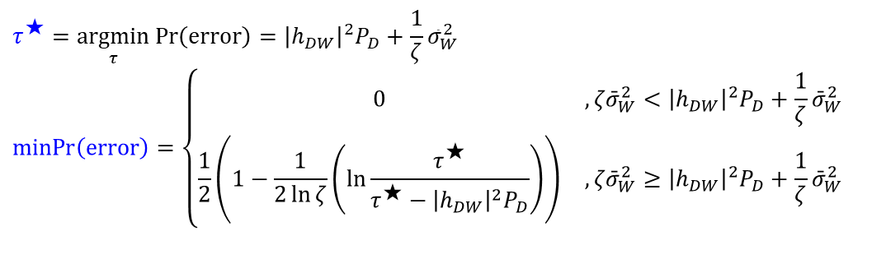

2. System model
2.3 Covert message detection
The worst-case assumption: $P_{D}$ known at the detector [HTa:20]
The minimum DEP and the optimal threshold $τ^{⋆}$
$$τ^{★}=\underset{τ}{argmin}\operatorname{Pr}\left(\text{error}\right)={\left|h_{DW}\right|}^{2}P_{D}+\frac{1}{ζ}{\bar{σ}}_{W}^{2} \\ \operatorname{minPr}\left(\text{error}\right)=\left\{\begin{matrix}0 & , ζ{\bar{σ}}_{W}^{2}<{\left|h_{DW}\right|}^{2}P_{D}+\frac{1}{ζ}{\bar{σ}}_{W}^{2} \\ \frac{1}{2}\left(1−\frac{1}{2\ln{ζ}}\left(\ln{\frac{τ^{★}}{τ^{★}−{\left|h_{DW}\right|}^{2}P_{D}}}\right)\right) & , ζ{\bar{σ}}_{W}^{2}≥{\left|h_{DW}\right|}^{2}P_{D}+\frac{1}{ζ}{\bar{σ}}_{W}^{2}\end{matrix}\right.$$

Slide 22
3. Problem formulation

Slide 23

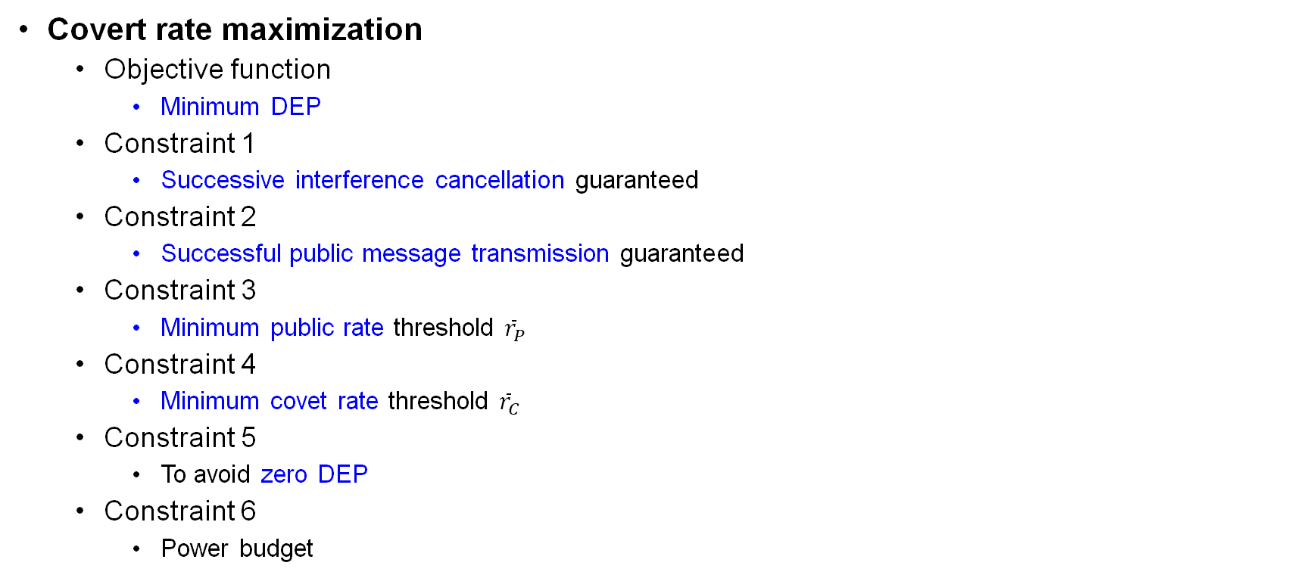
3. Problem formulation
Covert rate maximization
Objective function
Minimum DEP
Constraint 1
Successive interference cancellation guaranteed
Constraint 2
Successful public message transmission guaranteed
Constraint 3
Minimum public rate threshold ${\overline{r}}_{P}$
Constraint 4
Minimum covet rate threshold ${\overline{r}}_{C}$
Constraint 5
To avoid zero DEP
Constraint 6
Power budget
$$(\text{P}\text{1})\text{: }\max_{P_{D},r_{P}} \operatorname{minPr}\left(\text{error}\right) \\ \text{subject} \text{to} r_{P}≤{\bar{r}}_{P,R} \\ r_{P}≤{\bar{r}}_{P,D} \\ r_{P}≥{\bar{r}}_{P} \\ r_{C,R}≥{\bar{r}}_{C} \\ ζ{\bar{σ}}_{W}^{2}≥{\left|h_{DW}\right|}^{2}P_{D}+\frac{1}{ζ}{\bar{σ}}_{W}^{2} \\ 0≤P_{D}≤{\bar{P}}_{D}$$

Slide 24
4. Proposed solutions

Slide 25
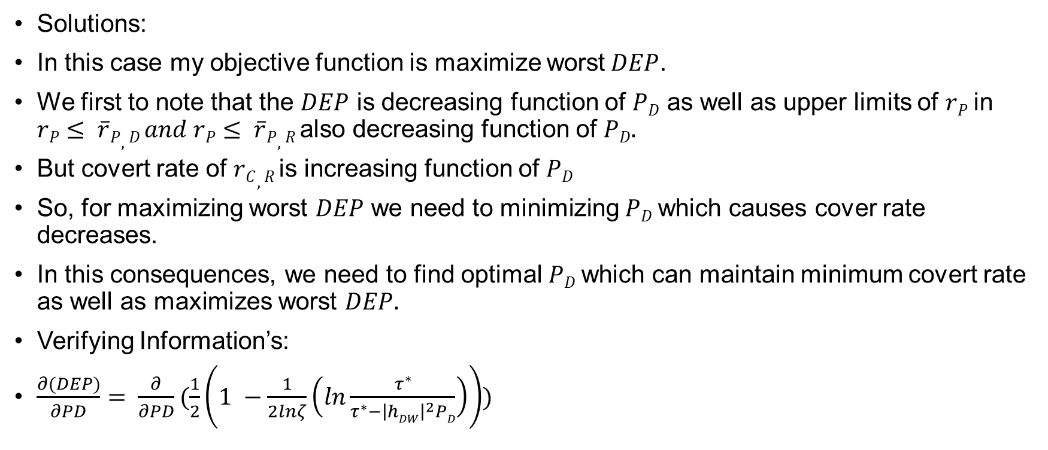
4. Proposed solutions
Solutions:
In this case my objective function is maximize worst$DEP$.
We first to note that the $DEP$ is decreasing function of $PD$ as well as upper limits of $rP$in $rP≤ \overline{r}P,D and rP≤ \overline{r}P,R$also decreasing function of $PD.$
But covert rate of $rC,R$is increasing function of $PD$
So, for maximizing worst $DEP$ we need to minimizing $PD$which causes cover rate decreases.
In this consequences, we need to find optimal $PD$which can maintain minimum covert rate as well as maximizes worst $DEP.$
Verifying Information’s:
$\frac{∂(DEP)}{∂PD}= \frac{∂}{∂PD}(\frac{1}{2}\left(1 −\frac{1}{2lnζ}\left(ln\frac{τ^{∗}}{τ^{∗}−{\left|hDW\right|}^{2}PD}\right)\right))$

Slide 26
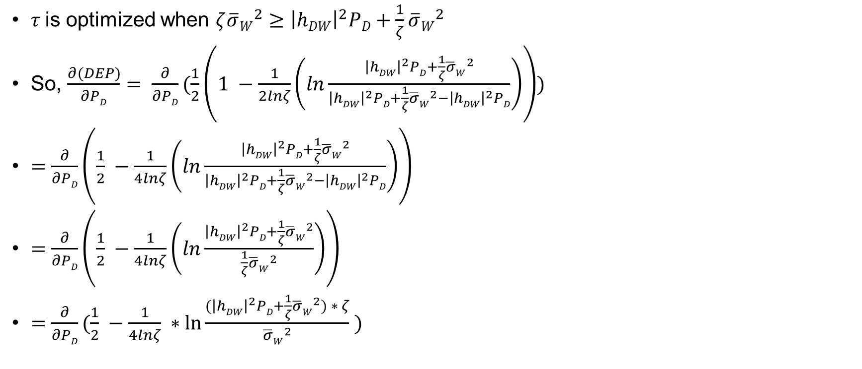
4. Proposed solutions
$τ$is optimized when $ζ{\overline{σ}W}^{2}≥{\left|hDW\right|}^{2}PD+\frac{1}{ζ}{\overline{σ}W}^{2}$
So, $\frac{∂(DEP)}{∂PD}= \frac{∂}{∂PD}(\frac{1}{2}\left(1 −\frac{1}{2lnζ}\left(ln\frac{{\left|hDW\right|}^{2}PD+\frac{1}{ζ}{\overline{σ}W}^{2}}{{\left|hDW\right|}^{2}PD+\frac{1}{ζ}{\overline{σ}W}^{2}−{\left|hDW\right|}^{2}PD}\right)\right))$
$=\frac{∂}{∂PD}\left(\frac{1}{2} −\frac{1}{4lnζ}\left(ln\frac{{\left|hDW\right|}^{2}PD+\frac{1}{ζ}{\overline{σ}W}^{2}}{{\left|hDW\right|}^{2}PD+\frac{1}{ζ}{\overline{σ}W}^{2}−{\left|hDW\right|}^{2}PD}\right)\right)$
$=\frac{∂}{∂PD}\left(\frac{1}{2} −\frac{1}{4lnζ}\left(ln\frac{{\left|hDW\right|}^{2}PD+\frac{1}{ζ}{\overline{σ}W}^{2}}{\frac{1}{ζ}{\overline{σ}W}^{2}}\right)\right)$
$=$ $\frac{∂}{∂PD}(\frac{1}{2} −\frac{1}{4lnζ} ∗\ln{\frac{{(\left|hDW\right|}^{2}PD+\frac{1}{ζ}{\overline{σ}W}^{2}) ∗ ζ}{{\overline{σ}W}^{2}}} )$

Slide 27
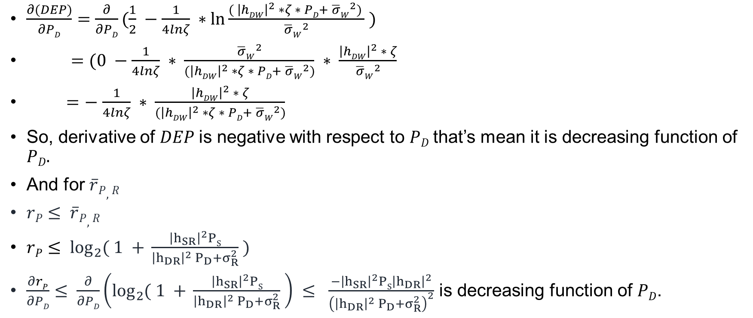
4. Proposed solutions
$\frac{∂(DEP)}{∂PD}=\frac{∂}{∂PD}(\frac{1}{2} −\frac{1}{4lnζ} ∗\ln{\frac{{( \left|hDW\right|}^{2} ∗ζ ∗ PD+ {\overline{σ}W}^{2}) }{{\overline{σ}W}^{2}}} )$
$=(0 −\frac{1}{4lnζ} ∗ \frac{{\overline{σ}W}^{2}}{{(\left|hDW\right|}^{2} ∗ζ ∗ PD+ {\overline{σ}W}^{2})} ∗ \frac{{\left|hDW\right|}^{2} ∗ ζ}{{\overline{σ}W}^{2}}$
$=−$ $\frac{1}{4lnζ} ∗ \frac{{\left|hDW\right|}^{2} ∗ ζ}{{(\left|hDW\right|}^{2} ∗ζ ∗ PD+ {\overline{σ}W}^{2})}$
So, derivative of $DEP$is negative with respect to $PD$that’s mean it is decreasing function of $PD.$
And for $\overline{r}P,R$
$rP≤ \overline{r}P,R$
$rP≤ \log_{2}{( 1 + }\frac{{\left|h_{SR}\right|}^{2}PS}{{\left|h_{DR}\right|}^{2} P_{D}+σ_{R}^{2}} )$
$\frac{∂rP}{∂PD}≤ \frac{∂}{∂PD}\left(\log_{2}{( 1 + }\frac{{\left|h_{SR}\right|}^{2}PS}{{\left|h_{DR}\right|}^{2} P_{D}+σ_{R}^{2}} \right) ≤ \frac{−{\left|h_{SR}\right|}^{2}PS{\left|h_{DR}\right|}^{2}}{{\left({\left|h_{DR}\right|}^{2} P_{D}+σ_{R}^{2}\right)}^{2}}$ is decreasing function of $PD$.

Slide 28
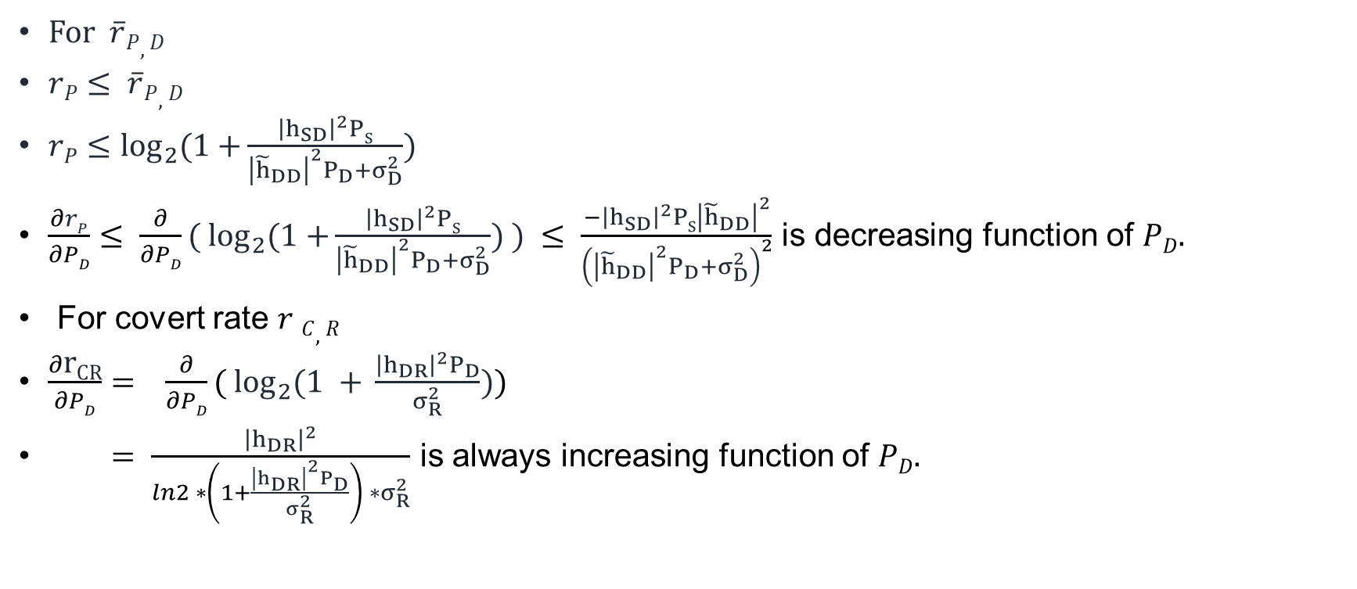
4. Proposed solutions
For $\overline{r}P,D$
$rP≤ \overline{r}P,D$
$rP≤\log_{2}{(1+}\frac{{\left|h_{SD}\right|}^{2}PS}{{\left|{\tilde{h}}_{DD}\right|}^{2}P_{D}+σ_{D}^{2}})$
$\frac{∂rP}{∂PD}≤ \frac{∂}{∂PD}{( log}_{2}{(1+}\frac{{\left|h_{SD}\right|}^{2}PS}{{\left|{\tilde{h}}_{DD}\right|}^{2}P_{D}+σ_{D}^{2}}) ) ≤ \frac{−{\left|h_{SD}\right|}^{2}PS{\left|{\tilde{h}}_{DD}\right|}^{2}}{{\left({\left|{\tilde{h}}_{DD}\right|}^{2}P_{D}+σ_{D}^{2}\right)}^{2}}$ is decreasing function of $PD.$
For covert rate $r C,R$
$\frac{∂\text{r}\text{CR}}{∂PD}= \frac{∂}{∂PD}(\log_{2}{(1 + }\frac{{\left|h_{DR}\right|}^{2}P_{D}}{σ_{R}^{2}}))$
$= \frac{{\left|h_{DR}\right|}^{2}}{ln2 ∗\left(1+\frac{{\left|h_{DR}\right|}^{2}P_{D}}{σ_{R}^{2}}\right) ∗σ_{R}^{2}}$ is always increasing function of $PD.$

Slide 29
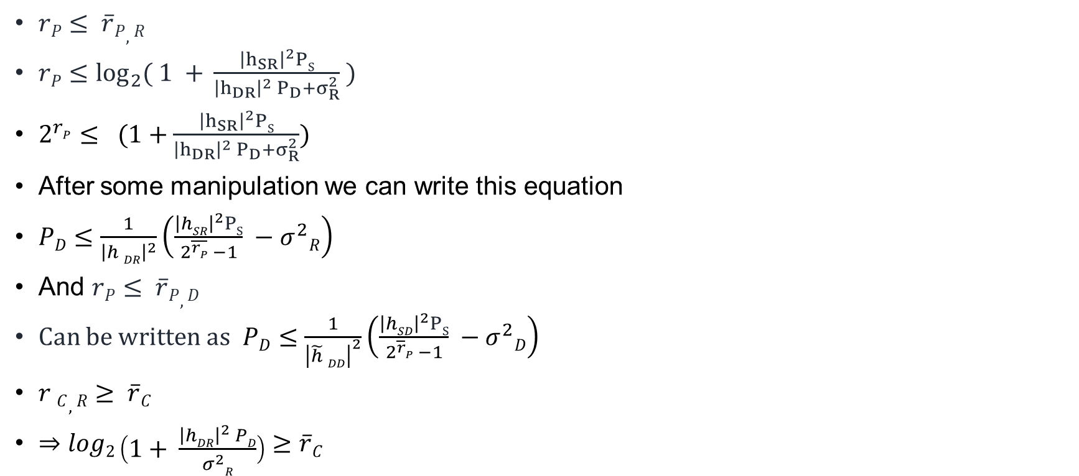
4. Proposed solutions
$rP≤ \overline{r}P,R$
$rP≤\log_{2}{( 1 + }\frac{{\left|h_{SR}\right|}^{2}PS}{{\left|h_{DR}\right|}^{2} P_{D}+σ_{R}^{2}} )$
$2^{rP}≤ (1+\frac{{\left|h_{SR}\right|}^{2}PS}{{\left|h_{DR}\right|}^{2} P_{D}+σ_{R}^{2}})$
After some manipulation we can write this equation
$PD≤\frac{1}{{\left|h DR\right|}^{2}}\left(\frac{{\left|hSR\right|}^{2}PS}{2^{\overline{rP}} −1} −σ^{2}R\right)$
And $rP≤ \overline{r}P,D$
Can be written as$PD≤\frac{1}{{\left|\tilde{h} DD\right|}^{2}}\left(\frac{{\left|hSD\right|}^{2}PS}{2^{\overline{r}P} −1} −σ^{2}D\right)$
$r C,R≥ \overline{r}C$
$⇒log2\left(1+ \frac{{\left|hDR\right|}^{2} PD}{σ^{2}R}\right)≥\overline{r}C$

Slide 30

4. Proposed solutions
$⇒ \left(1+ \frac{{\left|hDR\right|}^{2}PD}{σ^{2}R}\right)≥2^{\overline{r }C}$
$⇒\frac{{\left|hDR\right|}^{2}PD}{σ^{2}R} ≥2^{\overline{r }C} −1$
$⇒$ ${\left|hDR\right|}^{2}PD≥ {σR}^{2} (2^{\overline{r }C} −1)$
$⇒PD≥\frac{{σR}^{2}}{{\left|hDR\right|}^{2}} (2^{\overline{r }C} −1)$
And manipulating $ζ{\overline{σ}W}^{2}≥{\left|hDW\right|}^{ 2}PD+\frac{1}{ζ}{\overline{σ}W}^{2}$ we can write $PD≤\left(ζ −\frac{1}{ζ}\right)$ $\frac{{\overline{σ}W}^{2}}{{\left|hDW\right|}^{2}}$

Slide 31
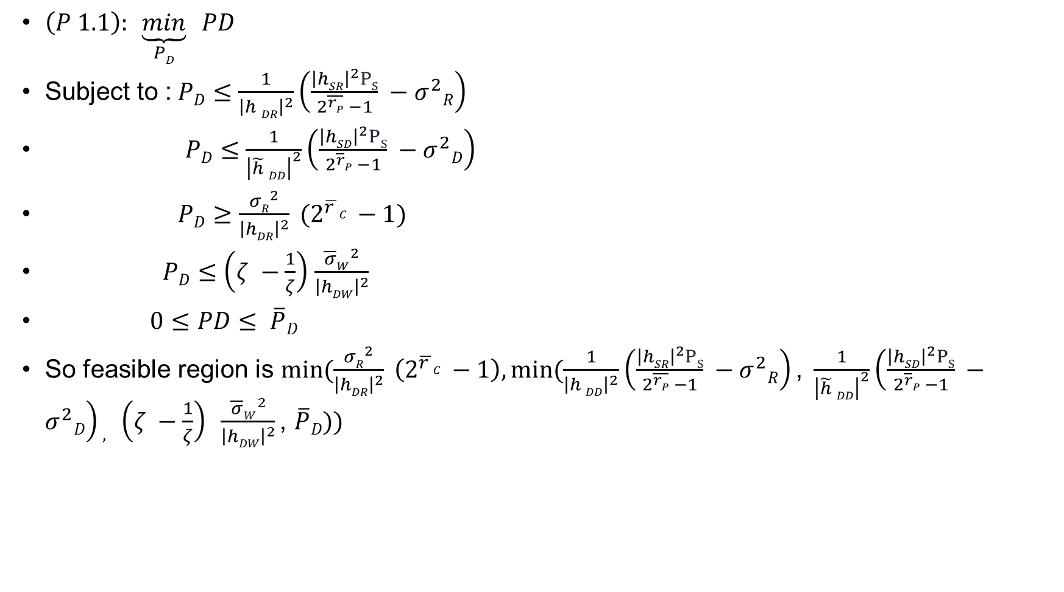
4. Proposed solutions
$\left(P 1.1\right):$ $\underset{PD}{\underbrace{min}} PD$
Subject to :$PD≤\frac{1}{{\left|h DR\right|}^{2}}\left(\frac{{\left|hSR\right|}^{2}PS}{2^{\overline{rP}} −1} −σ^{2}R\right)$
$PD≤\frac{1}{{\left|\tilde{h} DD\right|}^{2}}\left(\frac{{\left|hSD\right|}^{2}PS}{2^{\overline{r}P} −1} −σ^{2}D\right)$
$PD≥\frac{{σR}^{2}}{{\left|hDR\right|}^{2}} (2^{\overline{r }C} −1)$
$PD≤\left(ζ −\frac{1}{ζ}\right)$ $\frac{{\overline{σ}W}^{2}}{{\left|hDW\right|}^{2}}$
$0≤PD≤ \overline{P}D$
So feasible region is $min⁡(\frac{{σR}^{2}}{{\left|hDR\right|}^{2}} \left(2^{\overline{r }C} −1\right),min⁡(\frac{1}{{\left|h DD\right|}^{2}}\left(\frac{{\left|hSR\right|}^{2}PS}{2^{\overline{rP}} −1} −σ^{2}R\right)\text{, }\frac{1}{{\left|\tilde{h} DD\right|}^{2}}\left(\frac{{\left|hSD\right|}^{2}PS}{2^{\overline{r}P} −1} −σ^{2}D\right), \left(ζ −\frac{1}{ζ}\right) \frac{{\overline{σ}W}^{2}}{{\left|hDW\right|}^{2}}\text{, }\overline{P}D))$

Slide 32
5. Numerical results

Slide 33
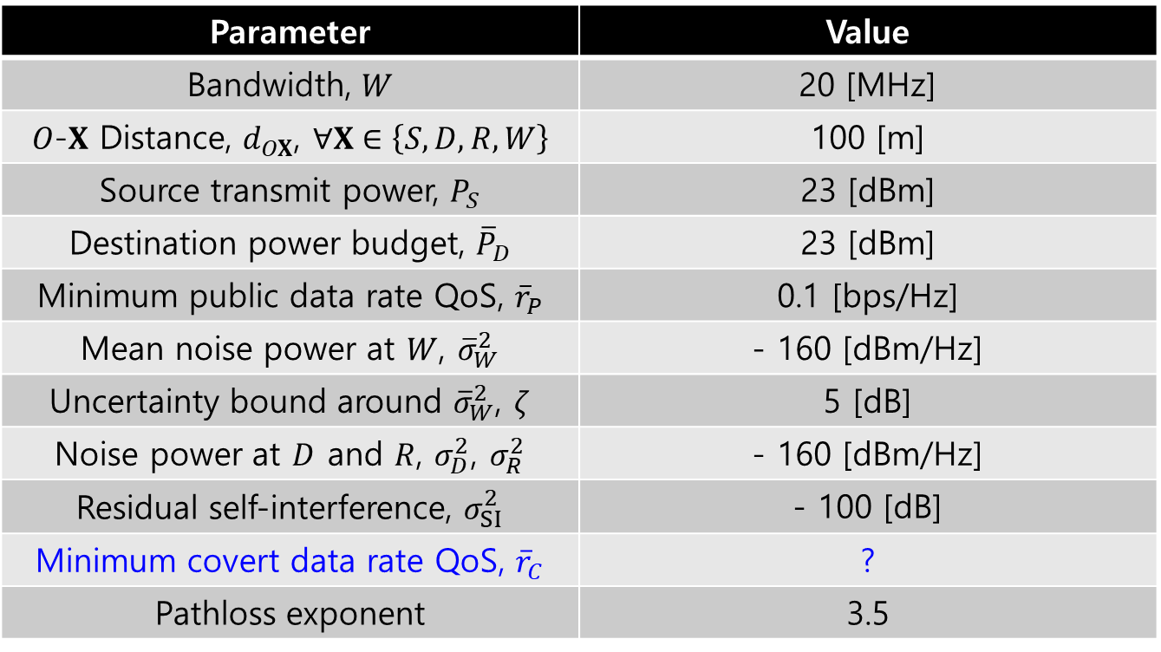
5. Numerical results
System parameter
Parameter | Value
Bandwidth, $W$ | 20 [MHz]
$O$-$X$ Distance, $d_{OX}$, $∀X∈\left\{S,D,R,W\right\}$ | 100 [m]
Source transmit power, $P_{S}$ | 23 [dBm]
Destination power budget, ${\overline{P}}_{D}$ | 23 [dBm]
Minimum public data rate QoS, ${\overline{r}}_{P}$ | 0.1 [bps/Hz]
Mean noise power at $W$, ${\overline{σ}}_{W}^{2}$ | - 160 [dBm/Hz]
Uncertainty bound around ${\overline{σ}}_{W}^{2}$, $ζ$ | 5 [dB]
Noise power at $D$ and $R$, $σ_{D}^{2}$, $σ_{R}^{2}$ | - 160 [dBm/Hz]
Residual self-interference, $σ_{SI}^{2}$ | - 100 [dB]
Minimum covert data rate QoS, ${\overline{r}}_{C}$ | ?
Pathloss exponent | 3.5

Slide 34
5. Numerical results
Node location

Slide 35

5. Numerical results
DEP vs. Source transmit power, $P_{S}$

Slide 36

5. Numerical results
DEP vs. Destination transmit power budget, ${\overline{P}}_{D}$

Slide 37

5. Numerical results
DEP vs. Minimum public rate threshold, ${\overline{r}}_{P}$

Slide 38

5. Numerical results
DEP vs. Residual self-interference, $σ_{SI}^{2}$

Slide 39

5. Numerical results
DEP vs. Minimum covert rate threshold, ${\overline{r}}_{C}$

Slide 40

5. Numerical results
DEP vs. Noise uncertainty bound, $ζ$

Slide 41
Appendix A

Slide 42
References
[HTa:20] S. W. Kim and H. Q. Ta, "Covert Communications Over Multiple Overt Channels," in IEEE Transactions on Communications, vol. 70, no. 2, pp. 1112-1124, Feb. 2022, doi: 10.1109/TCOMM.2021.3127532.
[BHe:17] B. He, S. Yan, X. Zhou and V. K. N. Lau, "On Covert Communication With Noise Uncertainty," in IEEE Communications Letters, vol. 21, no. 4, pp. 941-944, April 2017, doi: 10.1109/LCOMM.2016.2647716.
[JSi:21] J. Si et al., "Covert Transmission Assisted by Intelligent Reflecting Surface," in IEEE Transactions on Communications, vol. 69, no. 8, pp. 5394-5408, Aug. 2021, doi: 10.1109/TCOMM.2021.3082779.

Slide 43






Figure
Hidden Receiver, R
Covert message
Self-interference
Source, S
Public message
Disguised FD destination, D
Warden, W

